Slide 1
LEOTEK / R&D Weekly Report 智能開發處 / Software David

Slide 2
Weekly Report – 2023/01/26
● This week week 01/29 ~ 02/02
1. Deepstream obj_meta用於方向意圖分析
2. 多模型主程式對接 obj_meta
● Plan for next week 02/05 ~ 02/07
1. 智慧交警邏輯研究

Slide 3
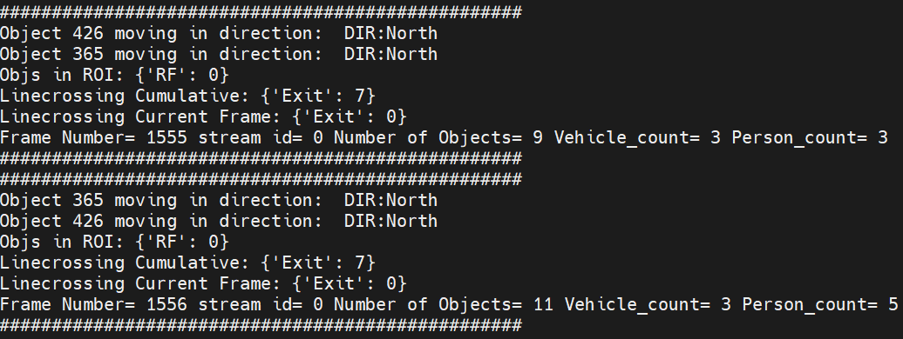
obj meta data 偵測車流/方向
Python3 import pyds
pyds.NvDsUserMeta.cast(l_user.data)
NvDsVehicleObject: alloc_nvds_vehicle_object()
NvDsPersonObject: alloc_nvds_person_object()
user_meta_data = pyds.NvDsAnalyticsObjInfo.cast(user_meta.user_meta_data)
(obj_meta.object_id, user_meta_data.dirStatus))
(obj_meta.object_id, user_meta_data.lcStatus))
(obj_meta.object_id, user_meta_data.ocStatus))
(obj_meta.object_id, user_meta_data.roiStatus))

Slide 4
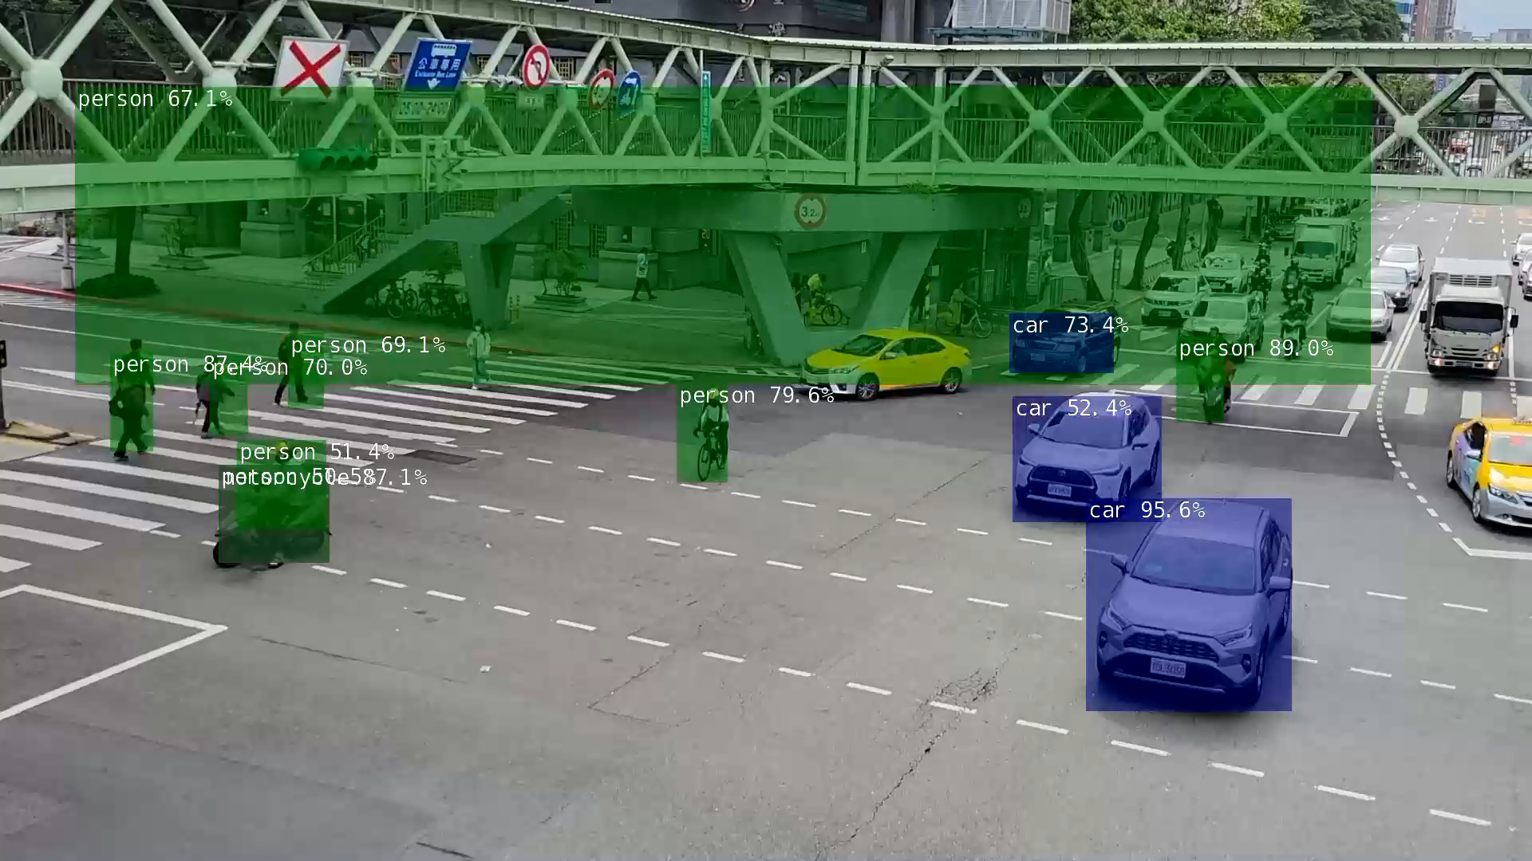
對接deepstream obj meta data

